Slide 1
Comparison of software life cycle models
Stovban Ivan

Slide 2
Content:
Cascade model
Iterative model
Spiral model
V-model
Comparative table of methodologies

Slide 3
Cascade model
A software development process model in which the development process looks like a flow, sequentially passing through the phases of:
requirements analysis
design
implementation
testing
integration
support
Requirements
Design
Implementation
Testing
Integration
Support

Slide 4
Cons - The need to approve the full scope of requirements for the system at the first stage; - if it is necessary to make changes to the requirements later, return to the first stage and rework all the work done anew; - increase in costs and time in case of need to change requirements.
Pros
- Full documentation of each stage;
- Clear planning of terms and costs;
- Transparency of processes for the customer.

Slide 5
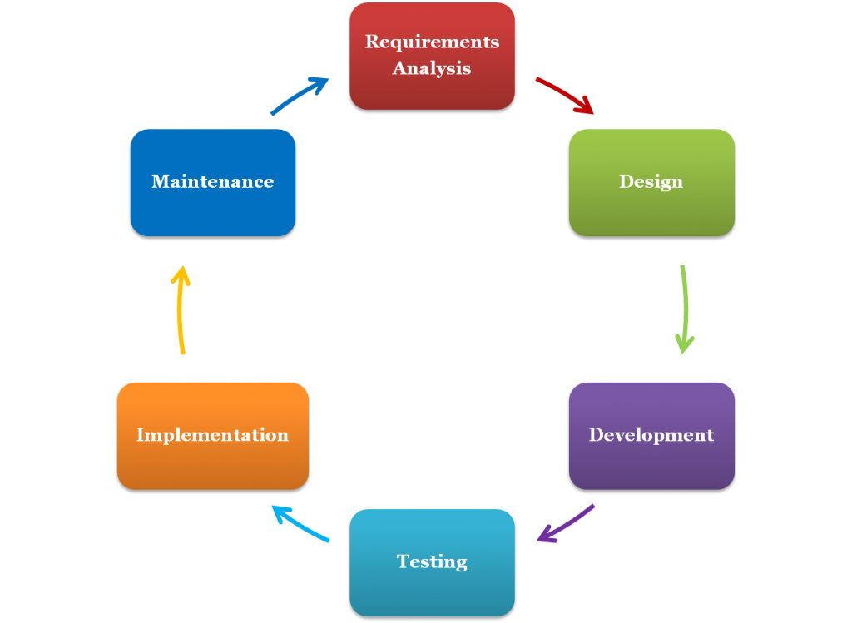
Iterative model
The life cycle of an iterative model does not begin with a complete specification of requirements. Instead, development starts with the definition and implementation of a piece of software that can then be revised to identify further requirements.
The process then repeats, creating a new version of the software for each cycle of the model.

Slide 6
Pros - Early creation of working software; - flexibility - readiness to change requirements at any stage of development; - each iteration is a small stage for which testing and risk analysis is easier to provide than for the entire product life cycle.
Cons
- each phase is independent, separate iterations do not overlap;
- there may be problems with the implementation of the overall system architecture, since not all requirements are known at the beginning of the design.

Slide 7
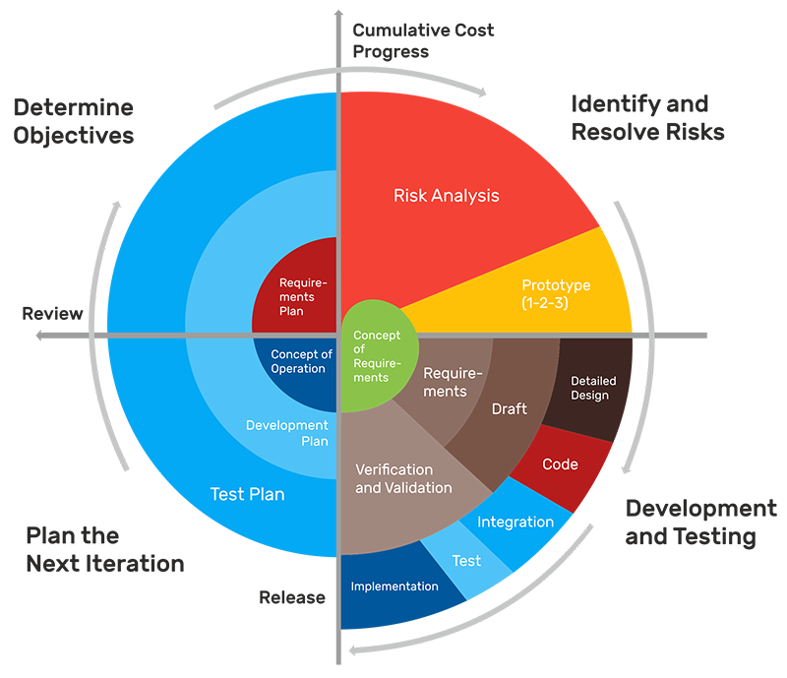
Spiral Model
The spiral model represents a software development process pattern that combines ideas from iterative and waterfall models.
Its essence is that the entire process of creating the final product is presented in the form of a conditional plane, divided into 4 sectors, each of which represents separate stages of its development.

Slide 8
- Improved risk analysis; - good documentation of the development process; - flexibility - the ability to make changes and add new functionality even at relatively late stages; - early creation of working prototypes.
Pros
Cons
- can be quite expensive to use;
- risk management requires the involvement of highly qualified specialists;
- the success of the process is highly dependent on the stage of risk analysis;
- not suitable for small projects.

Slide 9
V-model
Requirement Design
Acceptance test
The V-model is an improved version of the classic waterfall model. Here, at each stage, the current process is monitored in order to make sure that it is possible to move to the next level.
In this model, testing begins at the stage of writing requirements, and each subsequent stage has its own level of test coverage.
System Design
System
Test
Architecture Design
Integration Test
Modulel Design
Unit
Test
Coding

Slide 10
- Strict staging; - test planning and system verification are performed at early stages; - improved, in comparison with the waterfall model, time management; - intermediate testing.
Pros
Cons
- insufficient flexibility of the model;
- the actual creation of the program occurs at the stage of writing the code, that is, already in the middle of the development process;
- insufficient risk analysis;
- no work with parallel events and the ability to dynamically make changes.

Slide 11
COMPARATIVE TABLE OF METHODOLOGIES
 | Pros | Cons
Cascade model | - Full documentation of each stage; - Clear planning of terms and costs; - Transparency of processes for the customer. | - The need to approve the full scope of requirements for the system at the first stage; - if it is necessary to make changes to the requirements later, return to the first stage and rework all the work done anew; - increase in costs and time in case of need to change requirements.
Iterative model | - Early creation of working software; - flexibility - readiness to change requirements at any stage of development; - each iteration is a small stage for which testing and risk analysis is easier to provide than for the entire product life cycle. | - each phase is independent, separate iterations do not overlap; - there may be problems with the implementation of the overall system architecture, since not all requirements are known at the beginning of the design.
Spiral model | - Improved risk analysis; - good documentation of the development process; - flexibility - the ability to make changes and add new functionality even at relatively late stages; - early creation of working prototypes. | - can be quite expensive to use; - risk management requires the involvement of highly qualified specialists; - the success of the process is highly dependent on the stage of risk analysis; - not suitable for small projects.
V-model | - Strict staging; - test planning and system verification are performed at early stages; - improved, in comparison with the waterfall model, time management; - intermediate testing. | - insufficient flexibility of the model; - the actual creation of the program occurs at the stage of writing the code, that is, already in the middle of the development process; - insufficient risk analysis; - no work with parallel events and the ability to dynamically make changes.

Slide 12
Thank You ☺

